Slide 2
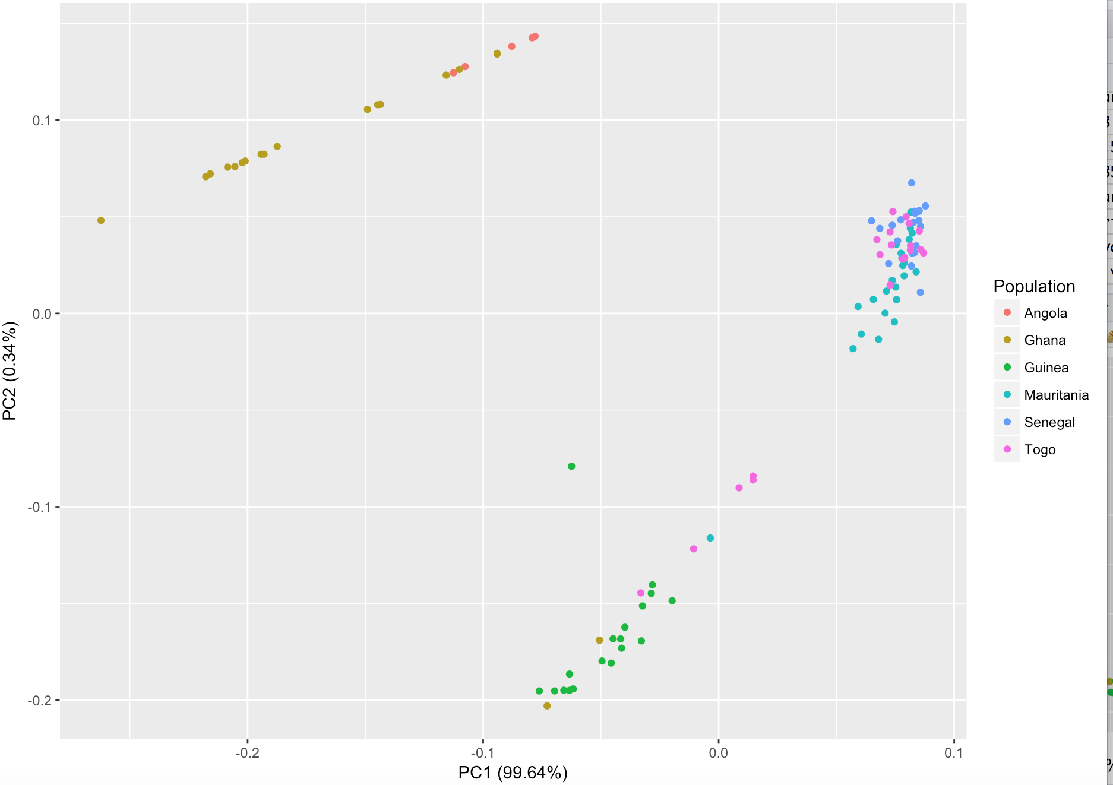
PCA plot

Slide 3
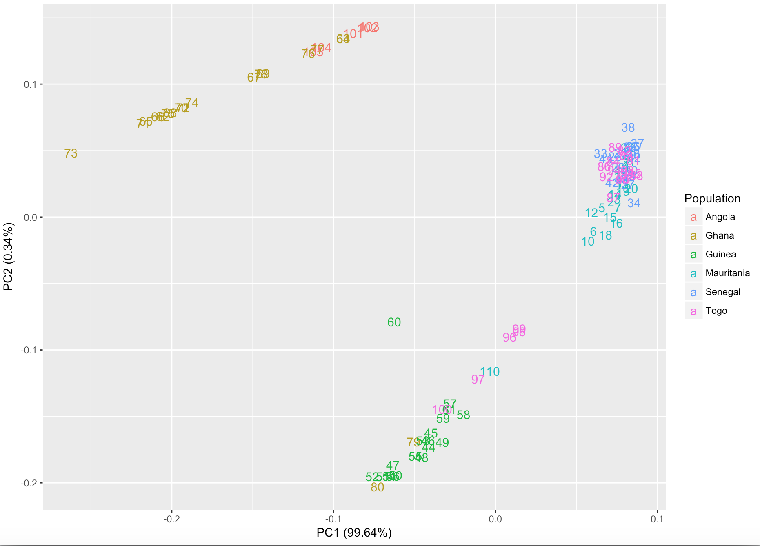
Country | sample used for assembly
Mauritania | 1,2,3,4,5
Senegal | 33,34,35,36,37
Guinea | 44,45,46,47,48
Ghana | 65,66,67,68,69
Togo | 92,93,94,95,96
Angola | 103,104,105,106,107

